Slide 1
Why DL outperforms ML in AI tasks
Sai Vishwak

Slide 2
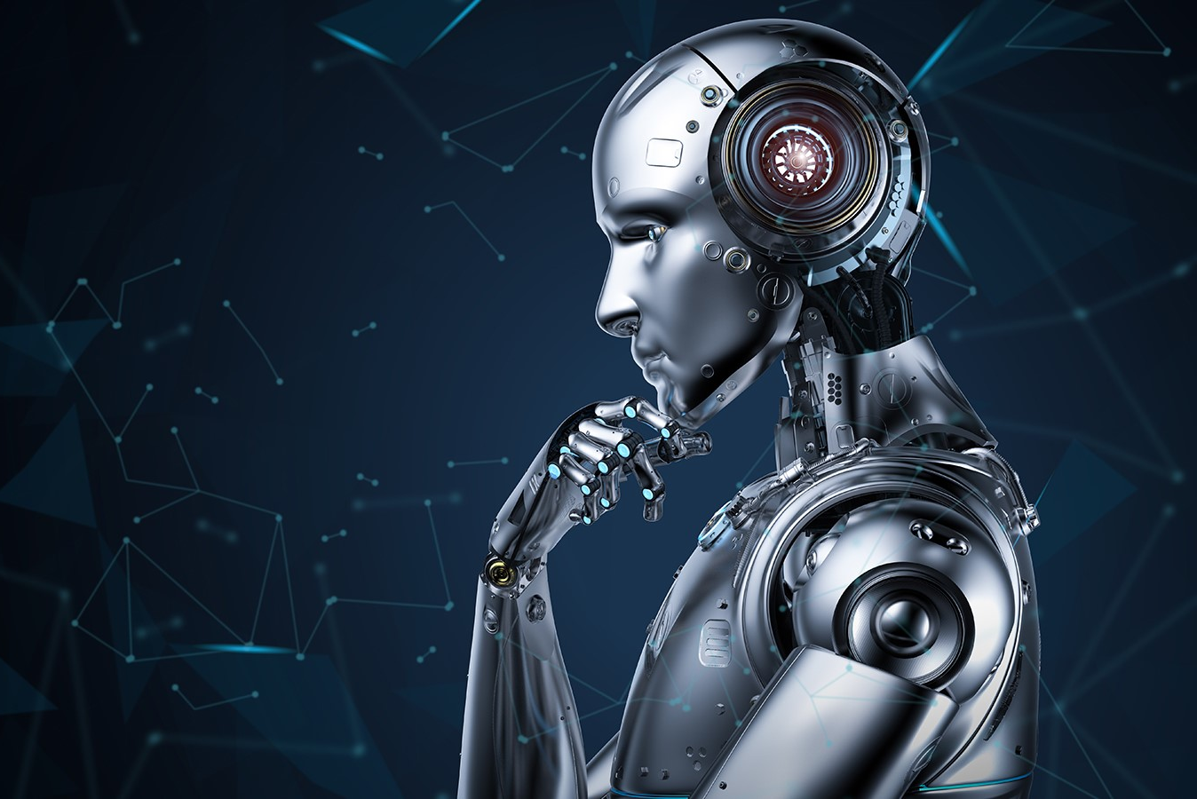
What is AI?
Artificial Intelligence is a scientific field that enables machines to mimic human intelligence.
AI systems learn from large amounts of data to identify patterns and make accurate predictions or decisions.

Slide 3
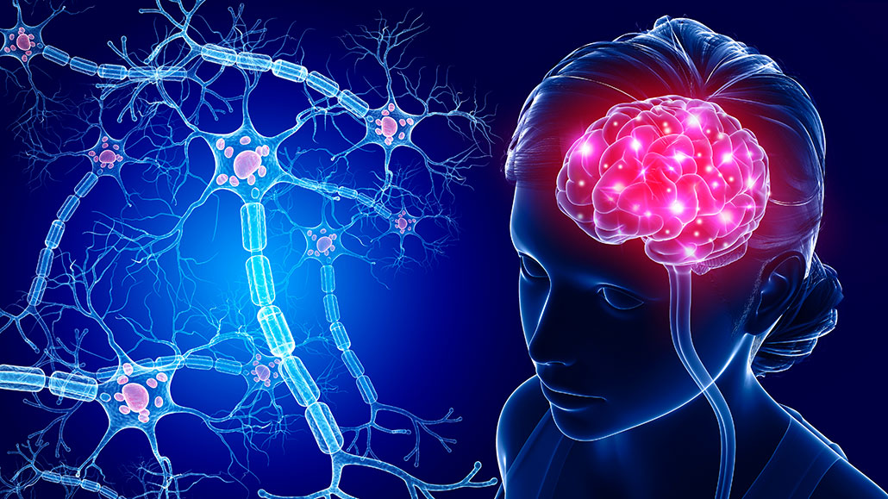
Why it’s hard to mimic a human
Human brain is a complex organ, with billions of neurons and nerves processing signals in parallel.
Highly efficient and adaptive compared to any AI model.
Applies context, memory, and common sense to solve complex tasks effortlessly.
Human intelligence is general-purpose, capable of reasoning, problem-solving, learning, and adapting to new challenges.

Slide 4
What are AI tasks?
Classification
Regression
Natural Language Processing
Computer Vision
Speech Analysis
Recommendation Systems
Insight generation
Anomaly detection
Notes:
Classification of data into categories
Regression for numerical predictions
Natural Language Processing for text understanding
Computer Vision for analyzing images and videos
Speech analysis and recognition
Recommendation systems for personalized choices
Insight generation from large datasets
Anomaly detection in unusual or rare events

Slide 5
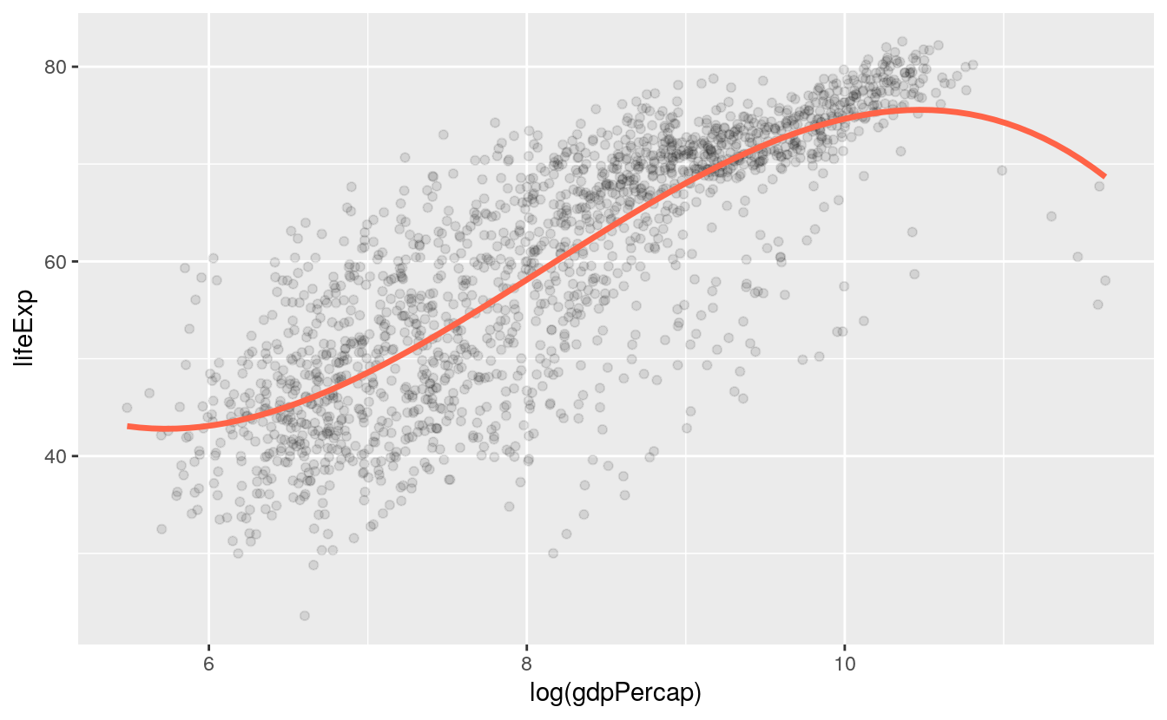
How ML is used for AI?
Machine Learning is a subset of AI that focuses on learning from data instead of explicit programming.
Uses structured datasets to discover patterns and apply them for making predictions or decisions.
ML algorithms adjust their internal parameters during training to fit data and improve accuracy.

Slide 6
Limitations of ML algorithms
They require structured and consistent datasets for effective learning.
Performance decreases significantly on unstructured data such as text, images, or audio.
ML models demand extensive preprocessing and feature engineering for data preparation.
As dataset complexity increases, models struggle and often require retraining from scratch.

Slide 7
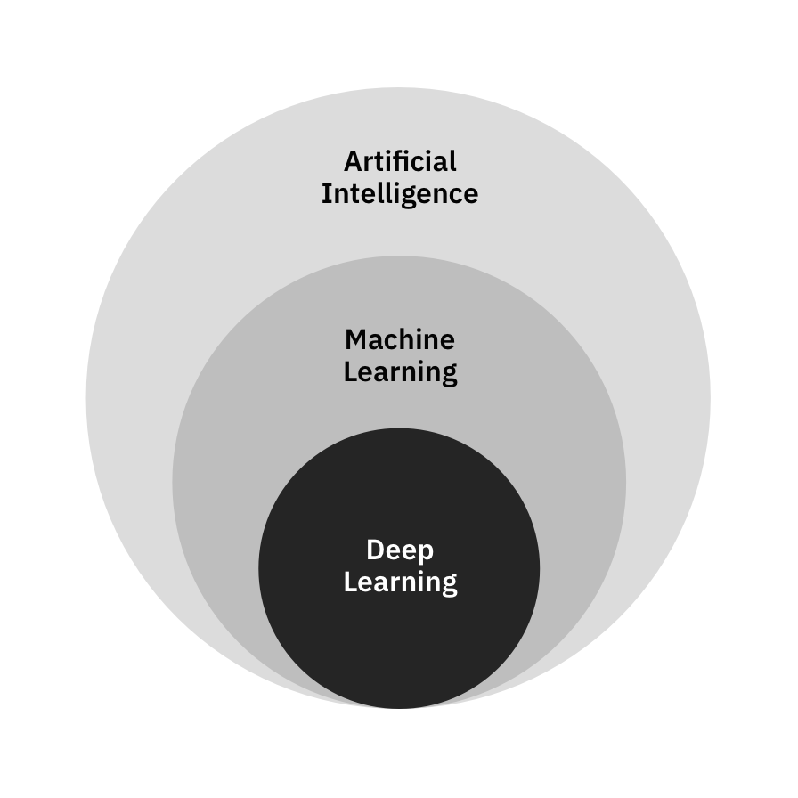
What is DL and its purpose
Deep Learning is a branch of ML that uses artificial neural networks inspired by the human brain.
Its main purpose is to learn patterns and extract knowledge from unstructured and highly complex non-linear data.
DL leverages GPUs and parallel processing to accelerate training and inference.

Slide 8
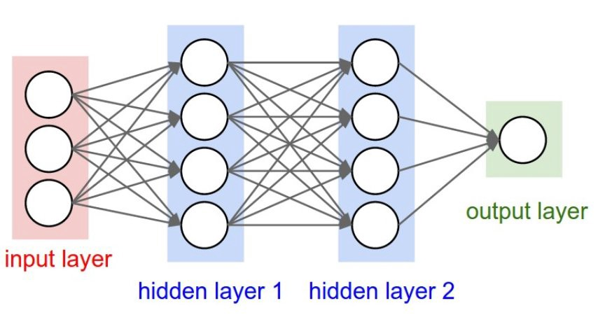
How DL works
A neural network is made of multiple layers with interconnected artificial neurons.
Data passes through these layers, with each neuron applying weights and biases to extract features.
Neurons capture increasingly complex patterns as information moves deeper through network.
The network learns using backpropagation, where weights are updated to minimize loss.

Slide 9
AI tasks solved by DL
Uncover hidden relationships in highly non-linear and complex datasets.
Process raw pixel data for image classification and object detection.
Understand meaning and context in unstructured text for NLP tasks like translation and sentiment analysis.
Used in Transformers BERT and GPT for text generation and contextual understanding.
Speech recognition, speaker identification, and real-time audio analysis.
Predictions
Image Processing
Artificial Intelligence
Transformers
Text Processing
Speech Analysis

Slide 10
Difference between DL and ML
Machine Learning | Deep Learning
Works effectively with structured data like SQL tables, CSV, spreadsheets. | Capable of handling unstructured data like text, audio, and images
Requires careful preprocessing and feature engineering. | Learns features automatically from raw data.
Struggles with highly complex and non-linear data, | Manages complex and non-linear automatically and easily.
ML models are usually predefined with limited flexibility | DL offers high customization tailored to specific tasks.

Slide 11
DL applications
Virtual assistants like Siri, Alexa, and Google Assistant for speech understanding
Self-driving cars for image recognition, path planning, and object detection
Healthcare research for drug discovery, medical imaging, and disease prediction
Text generation and translation through advanced models like GPT and BERT
Recommendation systems for shopping, movies, music, and personalized content

Slide 12
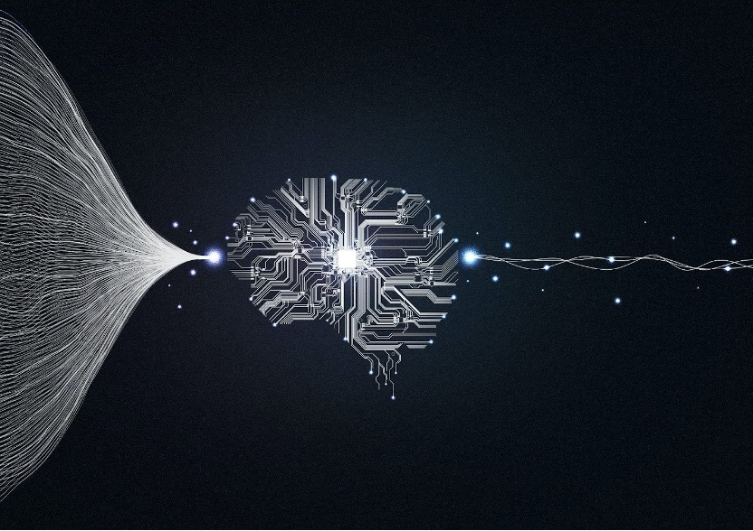
Conclusion
Deep Learning enables AI systems to solve a wide variety of real-world tasks by mimicking the human brain.
It achieves far superior performance and scalability compared to traditional machine learning approaches.
Its flexibility and adaptability allow for customization across different problems.
Deep Learning is the driving force behind many of today’s modern AI innovations and breakthroughs.

Slide 13
THANK YOU

